Slide 1
The Solar-Stellar Spectrograph (SSS) Project Review
JEFFREY HALL
LOWELL OBSERVATORY, FLAGSTAFF, AZ

Slide 2
Project Timeline
1988 1992 1996 2000 2004 2008 2012
Construction/early observing
Rebuild 1
Broad survey
Solar analog survey
Rebuild 2
A/D boundary

Slide 3
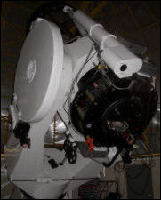
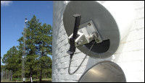
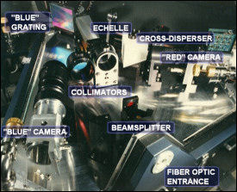
Instrumentation

Slide 4
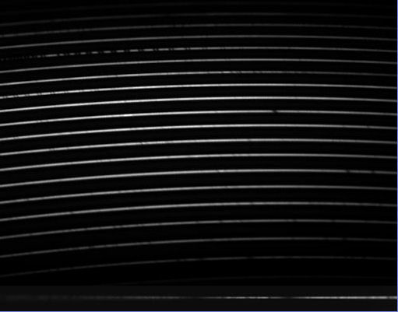
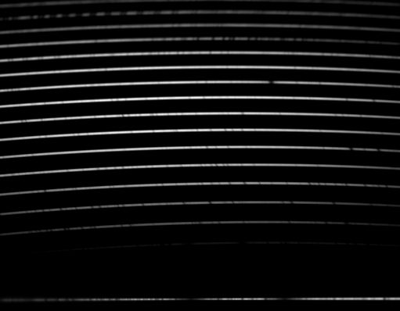
Raw Data
λλ 5126-8973
with gaps
λλ xxxx-xxxx
with gaps
λλ 3858-4012
λλ 3858-4012
1993-2007
2008-
Usual cadence:
Solar 3X/week
Stellar 5-7 nights of bright time per month

Slide 5
Extracted Spectra

Slide 6
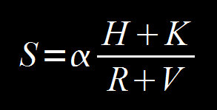
HK Spectrum Extraction and Analysis – 1
S → log R’_{HK} → ΔF_{HK}

Slide 7
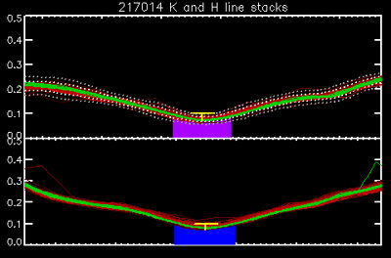
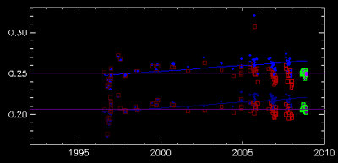
HK Spectrum Extraction and Analysis – 2

Slide 8
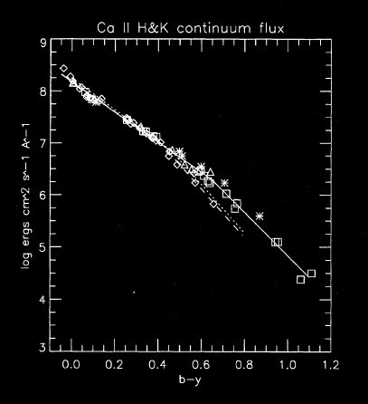
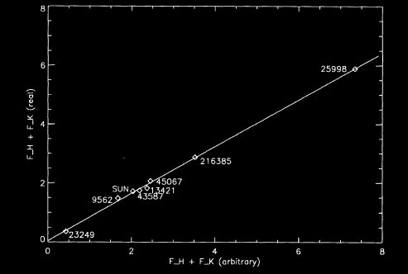
HK Spectrum Extraction and Analysis – 3

Slide 9
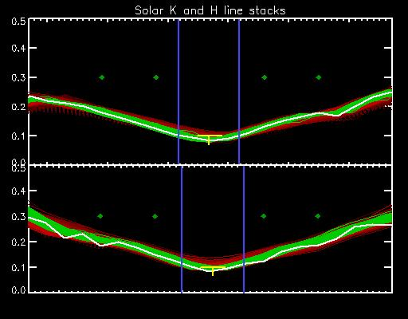
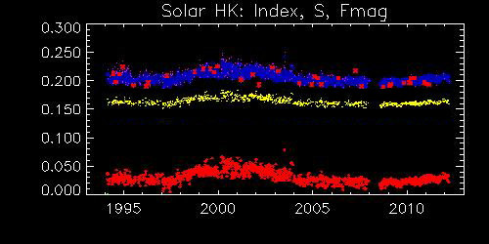
Time Series - Solar

Slide 10
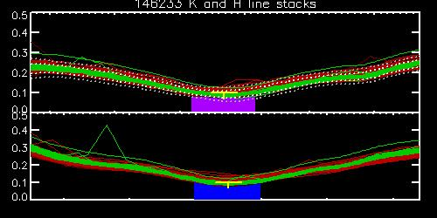
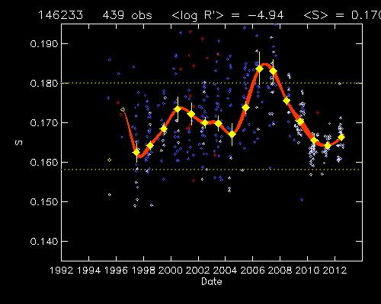
Time Series - Stellar

Slide 11
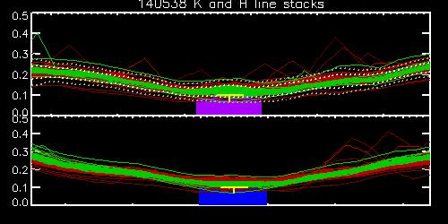
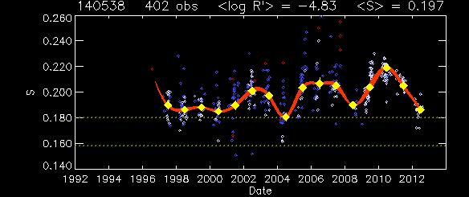
Time Series - Stellar

Slide 12
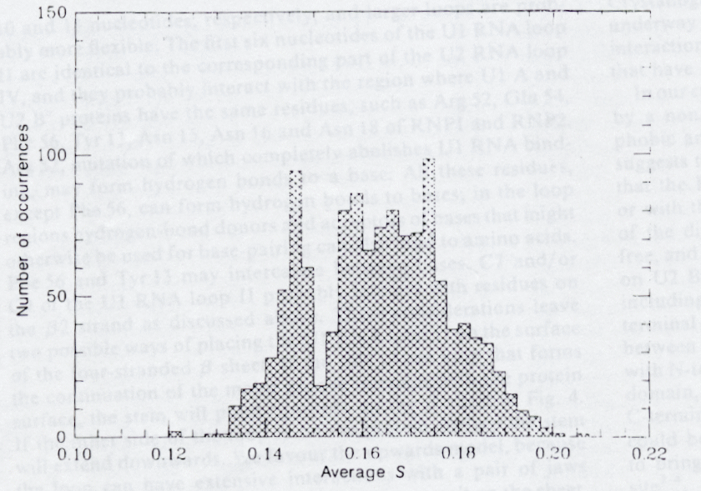
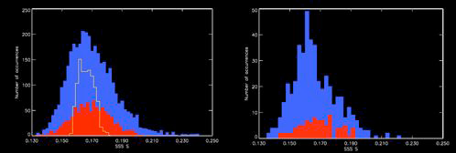
Ensemble Behavior
No unambiguous detection of a stellar Maunder Minimum

Slide 13
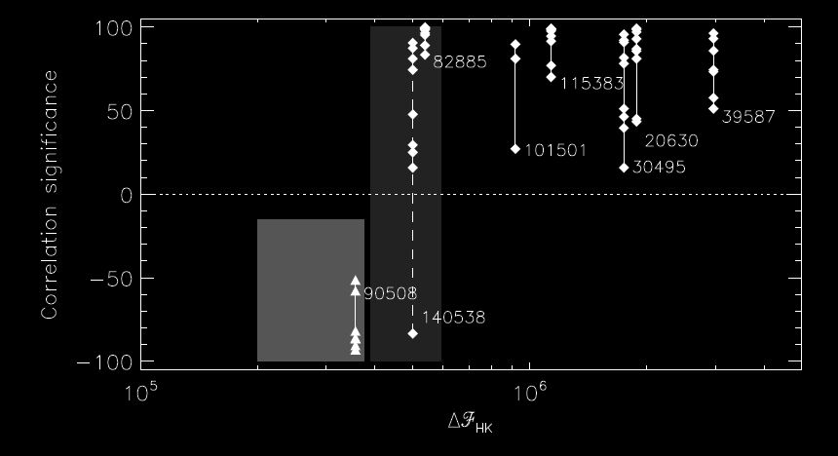
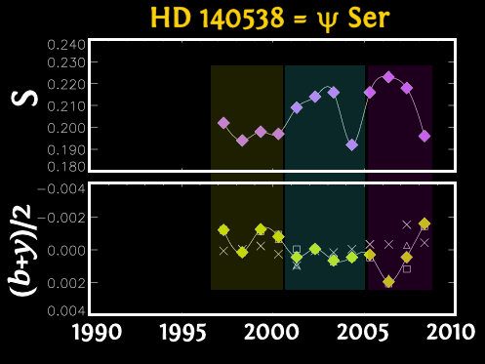
Ensemble Behavior
General recovery of the usual activity-brightness relationships

Slide 14
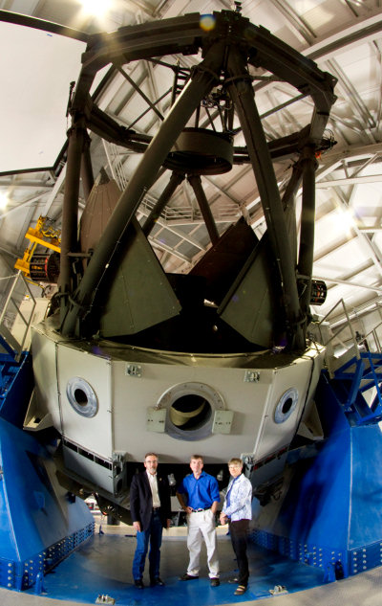
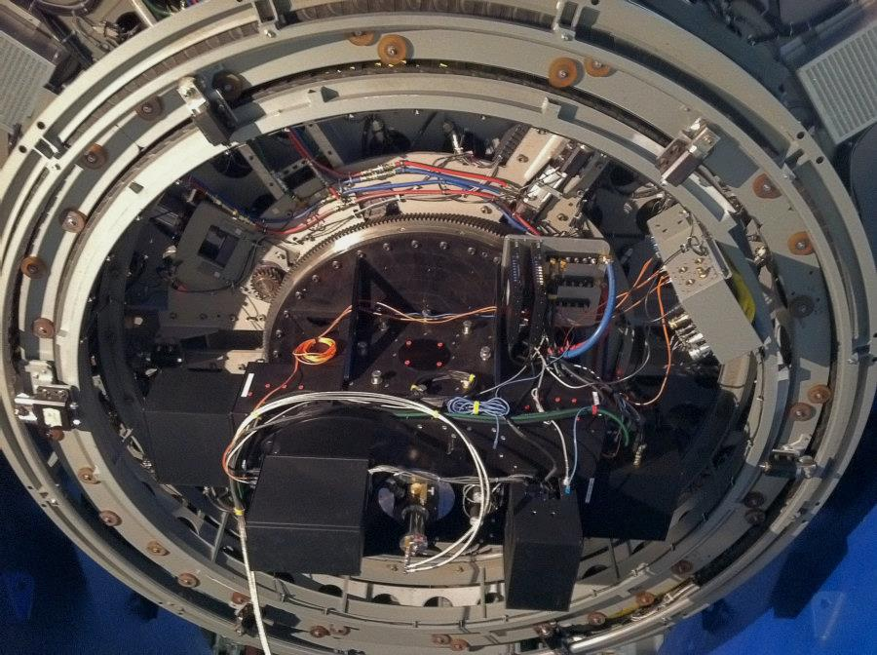
Future Directions

Slide 15
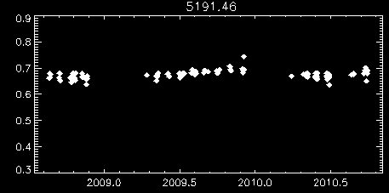
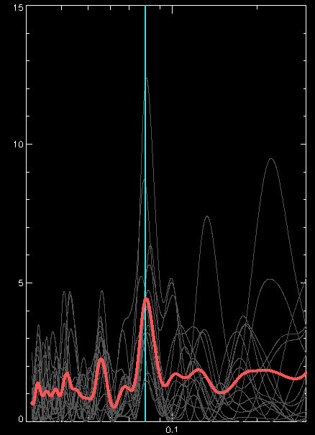
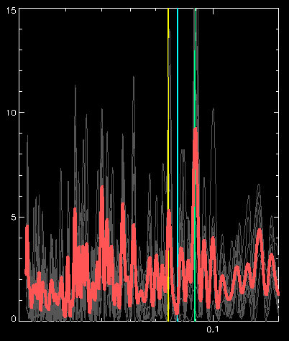
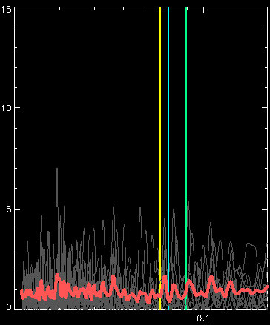
Future Directions
Composite proxies beyond HK
power
yr⁻¹

Slide 16
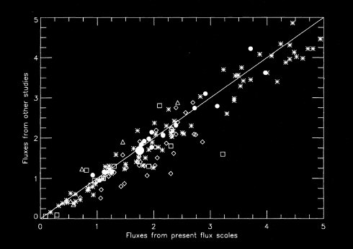
Connecting SSS to MWO – 1

Slide 17
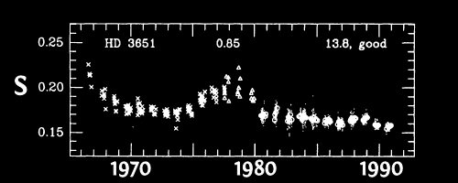
Connecting SSS to MWO – 2
We need a comprehensive linking, with individual observations and time series from other programs included.
Case study: the question of HD 3651

Slide 18
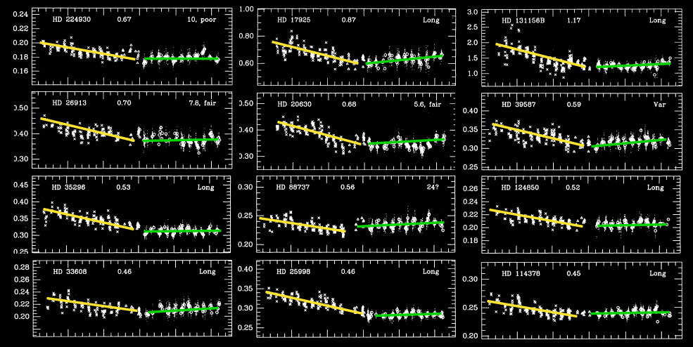
Connecting SSS to MWO – 2

Slide 19
Connecting SSS to MWO – 2
Principal MWO data compilations available in the literature:
> Duncan et al. 1991 ApJS 76 383
> Baliunas et al. 1995 ApJ 438 269
(grand mean S, yearly mean S)
MWO time series for select stars
> Radick et al 1998 ApJS 118 239
> Lockwood et al 2007 ApJS 171 260
(grand mean S, yearly mean S, individual observations)
Data analysis formerly overseen by Donahue (1990s)
Data currently curated by Soon

