Slide 1
Decadal variations of Sun-like stars (“solar variability after dark”)
Wes Lockwood, Lowell Observatory Gregory Henry, TSU
Notes:
Lowell observations of Sun-like stars began 30 years ago this month with an almost laughably primitive manually slewed 21-inch telescope equipped with position encoders and two old DEC minicomputer writing to 8 inch floppies. Success was assured however by the skill of observer Brian Skiff, who soldiered away for 15 years, 6000 stellar group observations and 1200 man hours. Three ApJ papers tell the story, the last of which incorporated several years of Fairborn APT data that extended the time series to as long as 17 years with up to 7 years overlap.

Slide 2
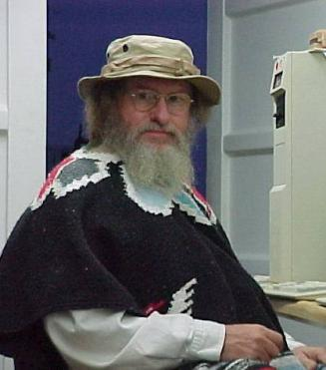
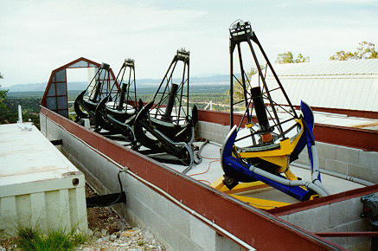
Robotic photometry 1993-2014
4 telescopes measure 300 Sun-like stars
Lou Boyd, input
Greg Henry, output
Tennessee State Univ. telescopes at Fairborn Observatory
Notes:
The Fairborn APT telescope farm now has 4 telescopes dedicated to Sun-like stars, 300 on current program, with duration of observation in the 10-20 year range. (Replacement of bad comp stars shortens some series)
Amazingly, Louis Boyd, sole proprietor, built all this and keeps it running singlehanded. Also amazingly, Greg Henry keeps up with data processing from these and other telescopes. See his extensive biblio on ADS, mainly in the exoplanet area.
Analysis of Sun-like stars has taken a back burner; we hope to remedy this soon. See the Decadal paper of 2013 for a quick tour of the results.

Slide 3
18 Sco, still our favorite solar twin
Notes:
!8 Sco was flagged as a good solar twin some years ago and has been on the Fairborn program for 18 years. Greg had the good fortune of selecting suitably stable comp stars early on, so now we have a long run of excellent data. This good fortune, as I shall show later, is a matter of luck with odds hardly better than the local casino.

Slide 4
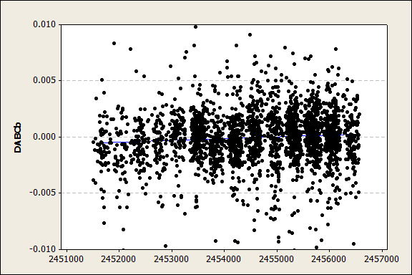
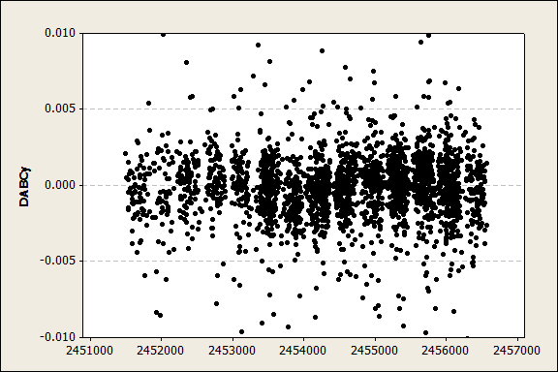
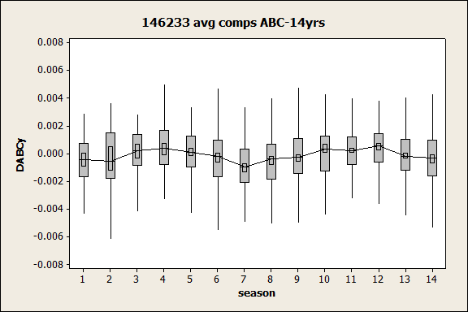
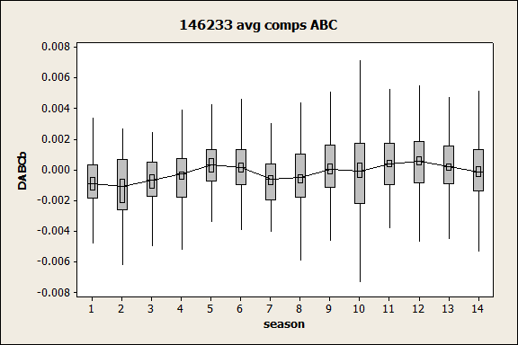
18 Sco, the “solar twin”
Fairborn observations 2000 – 2013 20124
Range ~0.1%
Notes:
The raw differential data, top panels is quite unimpressive. Can you see cycles? There are 2800 points on each panel.
But by averaging the differential magnitudes of 18 Sco minus each of three comp stars and taking annual medians (to suppress outliers) we see clear evidence of two consecutive cycles.
The outer boxes show the interquartile ranges, the inner boxes the uncertainty of the medians, and the connect line connects medians.
b and y data are shown separately here.

Slide 5
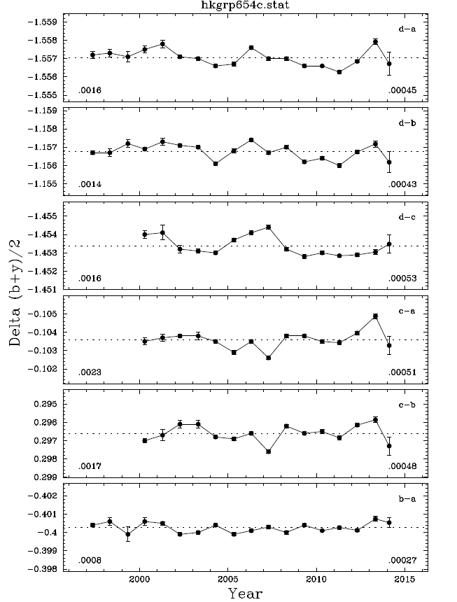
18 Sco minus star A
Range ~0.15%
18 Sco minus star B
Range ~0.13%
18 Sco minus rejected star C
star A minus rejected star C
rejected star C minus
star B
star B minus star A
(selected best comp pair)
Range ~0.08%
Notes:
Here’s another view as provided by Greg’s standard processing software after hand-editing out outliers. These show annual means with error bars, including a few 2014 points obtained just recently.
There are 6 pairwise differential mags, the top 3 are program minus each comp. and the bottom three show each comp minus another.
Clearly comp star C is inferior as shown by the rms numbers at lower left and by inspection. I’ve X-ed out all the light curves that include star C.
The best result therefore uses the mean of 18 Sco minus star and 18 Sco minus star B. Top two and bottom panel
Think about inspecting 300 such panels and making decision

Slide 6
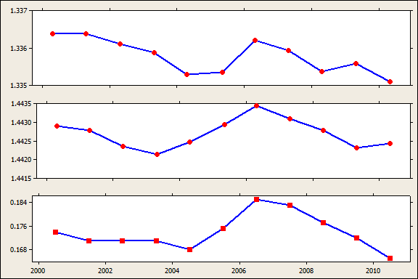
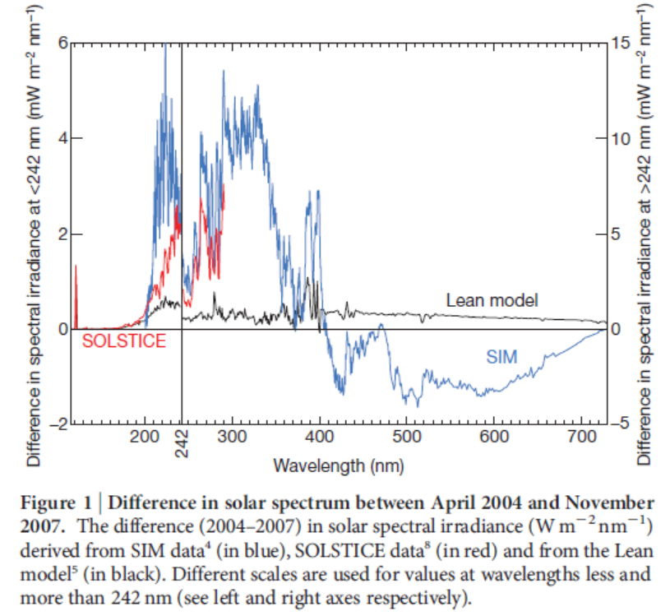
18 Sco’s Ca II and brightness variation vs. SORCE SIM surprise
b mag
b y
y mag
S index
b, y, and S are positively correlated in 18 Sco, as we find for most solar age stars...
…but SIM suggests b and y should vary differently
Notes:
Recall the SORCE SIM result that seemed to indicate that b and y would vary differently if we measured the Sun as a star from afar ?
The status of the reprocessing of SIM data is not known to me, but we can test against an ensemble of Sun-like stars including 18 Sco shown on the left hand panels.
The top two panels are b,y data through 2011. They are clearly similar and contradict the SIM solar result which would predict no variation in b, but some in y.
The bottom panel is Lowell S, Ca II emission, and it’s in phase with b,y as it is for the Sun. No surprises here.

Slide 7
The larger sample
Notes:
A 2012 invitation to a meeting in Mexico prompted examination of a large sample the 300 stars, those with more than 10 years observation (122 survivors). This was a follow-on and extension of some work we did in collaboration with Phil Judge.
From this extended sample we can now learn quite more than we had from the 15 year Lowell program because
1 – the APT data has better long term precision.
2- the sample is 10x larger
3 – the number of obs/year is about 10x greater per star

Slide 8
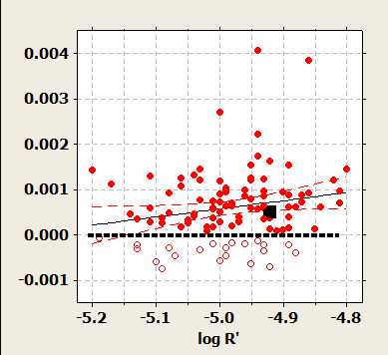
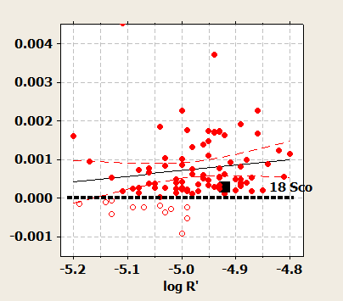
Variability of the “solar twins”
b (472 nm ) y (571 nm)
A few stars have “negative” net variance due to comp. star variability
Notes:
This is a key result, the trend of rms variability, year to year in the log R’ range that brackets the solar value about -4.94.
The curvy lines are a 95% CI on the regression.
18 Sco is the black box. On this chart the Sun would be nearby.
Note a significant number of stars have a meaningless ‘negative variance’ owing to comp star intrinsic variability. This is a hazard in this program and it’s painful. The variance arithmetic also includes a small fixed term of unknown origin, but it’s clearly needed.

Slide 9
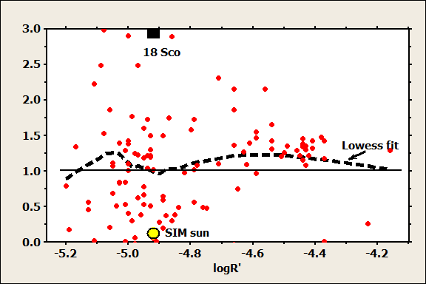
Variance in b / variance in y
Notes:
Getting back to the SIM result, can we show that b varies less than (counterintuitive) more than ( expected) y? The scale here is variance RATIO, not sigma.
The locations of 18 Sco and the Sun are shown.
18 Sco is quite an outlier. Is this an observational artifact of some kind of comp. star discrepancy? Further investigation needed.
The lowess fit shows that over most of the range the ratio is positive, with about 10% excess, indicating with some confidence that as a rule, b varies more than y, consistent with blackbody expectations. We knew this already in 1992, Nature paper! But larger sample is comforting.

Slide 10
Could we detect the Sun’s variability?
Yes, but only for about 30% of the comparison star pairs
Cumulative distribution of comp. star rms
measurement noise
b
y
ACRIM data degraded to 18 Sco window and precision
Notes:
Could we detect the Sun’s variability?
Rich Radick dumbed down the SORCE ACRIM data to the APT noise level, and using the same data window as for 18 Sco, produced simulated photometric data in the lower panel on the left hand side. TSI on upper pane;
Clearly, we see a declining cycle and if you recall the 18 Sco raw data shown earlier, the noise is similarly displayed.
The next question is “how many comp star pairs are quiet enough to show solar levels of variability in a program star. This cumulative histogram on the right shows the depressing result that only about 30%of the extant comp stars used at the Apt pass this test. C’est la vie.

Slide 12
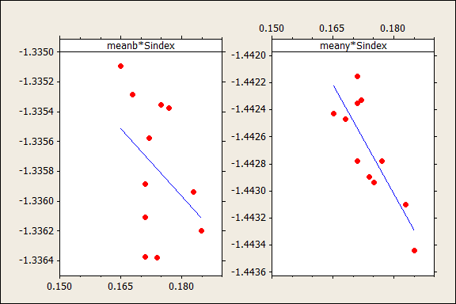
18 Sco brightness - activity variation
Solar cycle 23
brighter

Slide 13
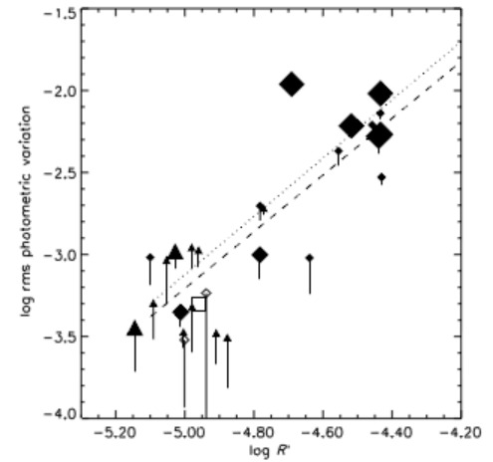
Activity-brightness correlation
The enlarged sample confirms earlier results
Age
122 stars 28 stars

Slide 14
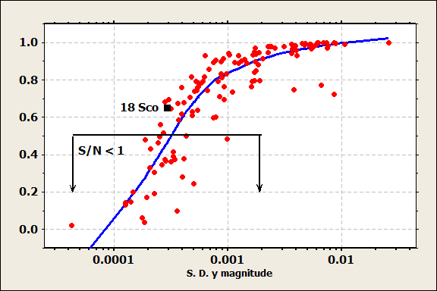
Detection sensitivity
S/N of detection falls rapidly for σ < 0.0003 mag rms

Slide 15
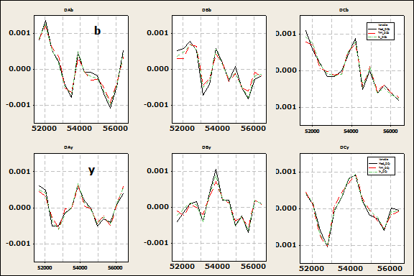
18 Sco minus each comp. star

Slide 16
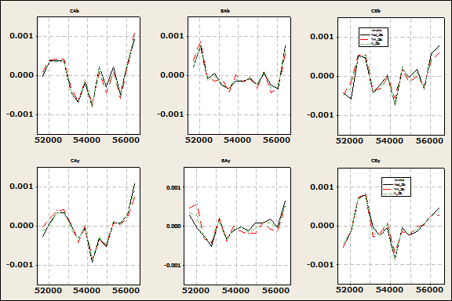
Comp. star differential mags
b
Best pair
A and B
y

Slide 17
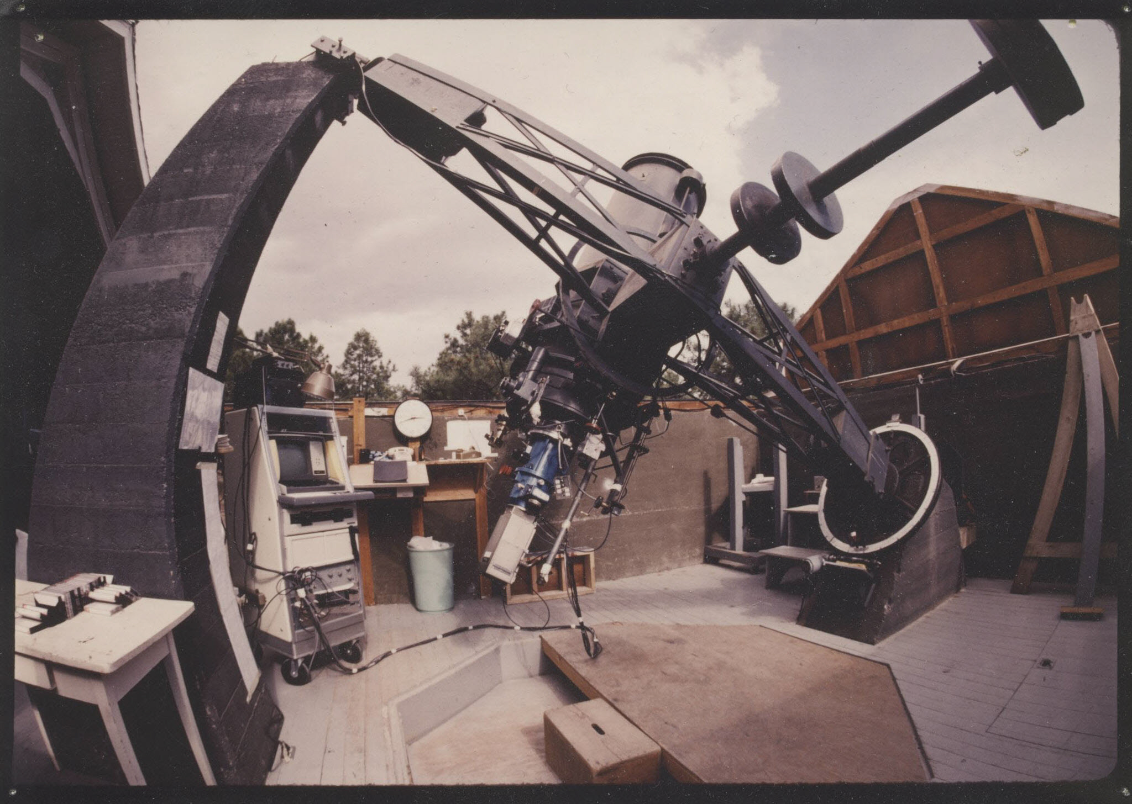
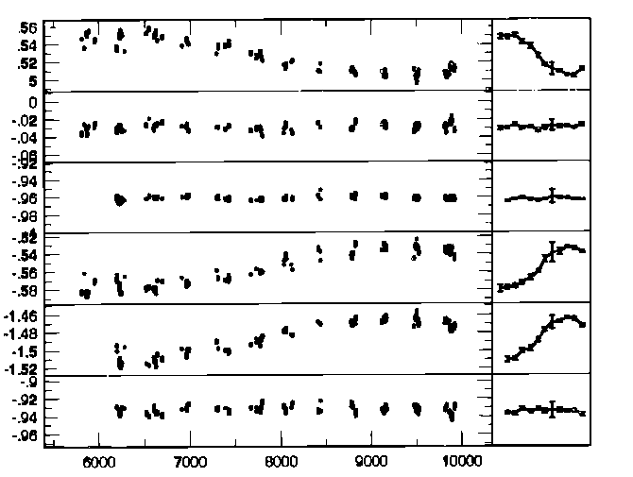
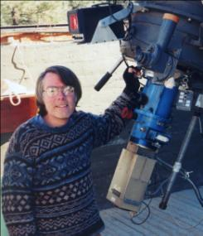
1984-2007: Measuring sunlike stars
1200 nights, 15 years, 6000 data sets,
32 program stars, one (!) observer
Lowell 0.5-m telescope
Brian Skiff, observer
night by night year by year
Notes:
In 1984, we began b,y photometry of about 3 dozen Sun-like stars using the 21-inch telescope at Lowell. This telescope was built, actually, by Johnson in 1953. It has been a strictly photometric telescope for 59 years, and it is still in use for some photometry of planets. The telescope has produced 127 papers since 1953, in Science, Nature, ApJ, AJ, PASP, and Icarus.
Brian Skiff at the telescope on one of 1200 nights. Brian devoted about 3 man years over a decade and a half, observing solo on this funded project.
These are pairwise lightcurves of the four stars of a quartet group containing a star with a cyclical variation of about 0.06 mag.
Our data now extend to 28 years, counting the additions from Fairborn Observatory robot telescopes.
One of the first things we discovered was that a number of uvby standard stars are VARIABLE at the mmag level.
Example light curves are pairwise differential time series of a quartet of stars, 12, 13, 14, 23,24, 34. Correlation reveals variability.

Slide 18
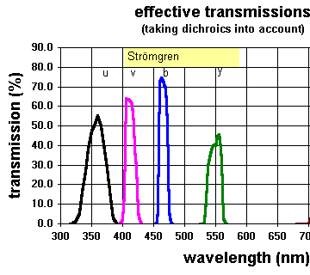
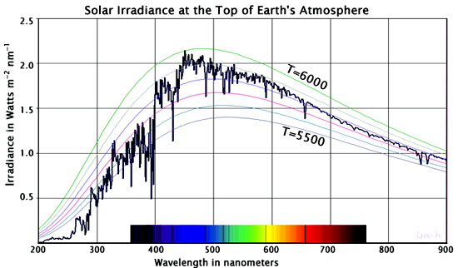
What we measure
Location of
Strömgren b & y passbands
b y
Notes:
This shows that b,y lie near the peak of solar spectral irradiance.

Slide 19
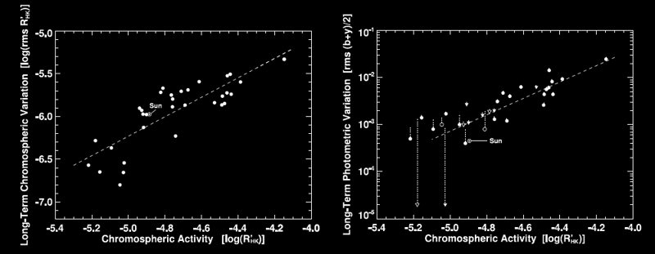
Activity-brightness correlations
HK activity
brightness variation
Age
Age
Age

Slide 20
Stellar activity & brightness variation
HD1835 - a non-cycling star HD10476 – a cycling star
Ca II
HD 1835 - a non-cycling star
HD 1835 - a non-cycling star
(b+y)/2
comp. star

Slide 21
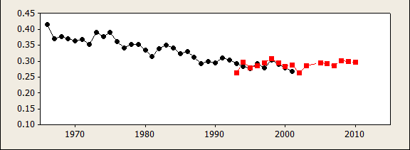
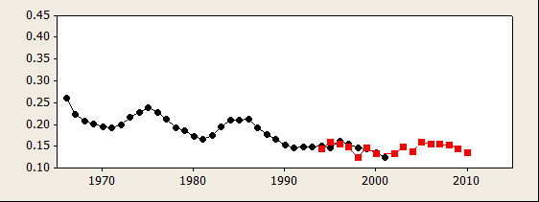
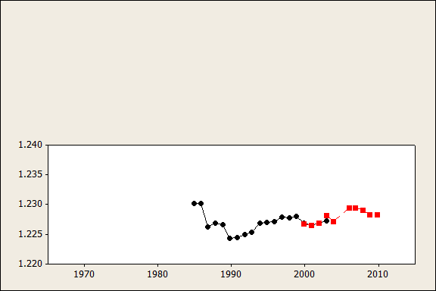
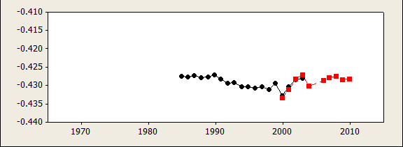
A 45 - year perspective
HD 1835 - a non-cycling star
HD 10476 – a cycling star
Ca II
(b+y)/2
comp. star

Slide 22
Stellar activity & brightness variation
HD1835 - a non-cycling star HD10476 – a cycling star
10%
Ca II
(b+y)/2
1%
comp. star

Slide 23
Stellar activity & brightness variation
HD1835 - a non-cycling star HD10476 – a cycling star
10%
Ca II
(b+y)/2
1%
comp. star

Slide 24
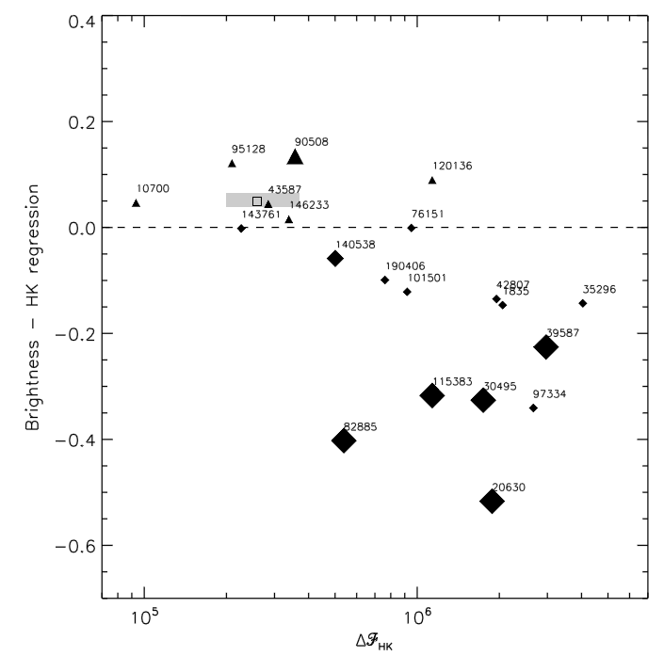
Ratio of brightness & activity variation
Sun
Positive correlation
18 Sco
Negative correlation

Slide 25
Why this is a tough problem: stellar variability across the HR diagram
Here’s the Sun
Illustration by M. Grenon
Notes:
This 20-year old diagram shows variability within the HR diagram and shows that the Sun lies in an oasis of stability.
(It’s good that we did not see this diagram in 1984 because if we had we never would have attempted to measure variability in Sun like stars
The Sun appears in a fly in animation.

