Slide 1
Magnetic activity of F stars
Savita Mathur
Space Science Institute

Slide 2
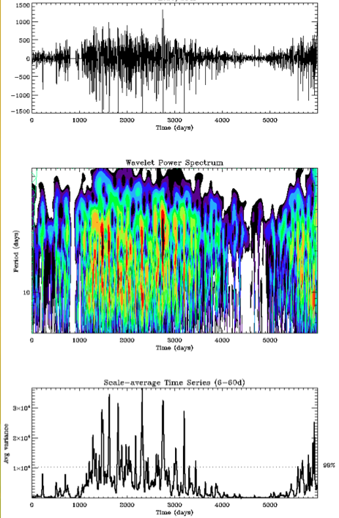
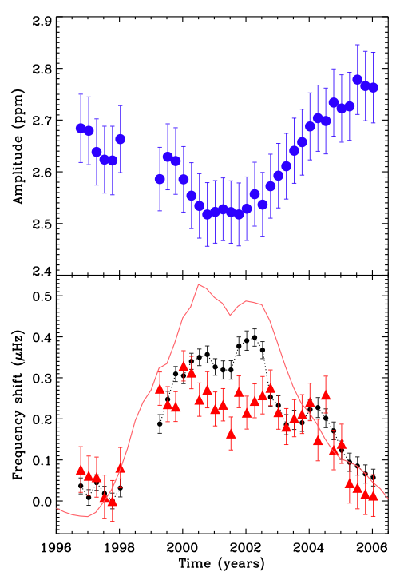
Magnetic activity: photometry
VIRGO/SPM
VIRGO/SPM
Sunspot number
[Mathur et al. 2013]
[García et al. 2010]
[Salabert et al. 2009]
Notes:
Red: cross-correlation
Black: individual modes
WITH RADIO FLUX

Slide 3
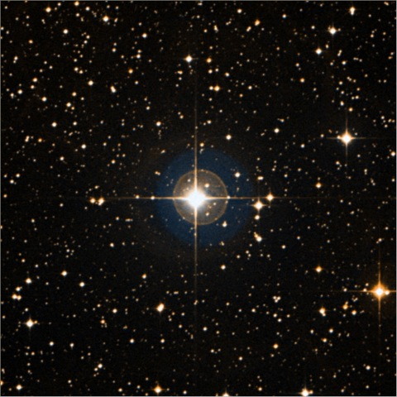
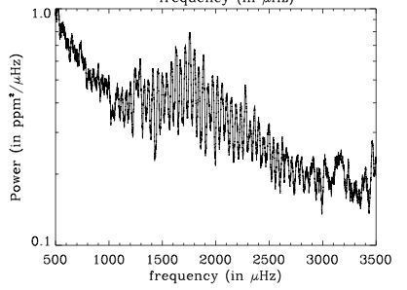
The CoRoT target: HD49933
Stellar parameters:
F5V dwarf
1.2 M; 1.3 R
Observed by CoRoT during 60 + 137 days + 90 days
50 oscillation modes measured
P_{rot} = 3.4 days
//
//
//
//
[Appourchaux et al. 2008; Benomar et al. 2009]

Slide 4
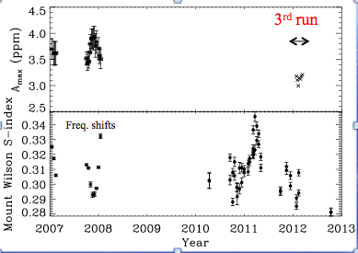
Hints of a magnetic-activity cycle
Seismology
HD49933
Spectroscopy
[García et al. 2010]
Complementary observations
Ca HK: Mount Wilson index of 0.31
Active star
Anticorrelation between amplitude variation and frequency shifts
Pcyc>120days
Notes:
Red: individual modes
Black: cross-correlation
Mathur, Metcalfe in prep.

Slide 5
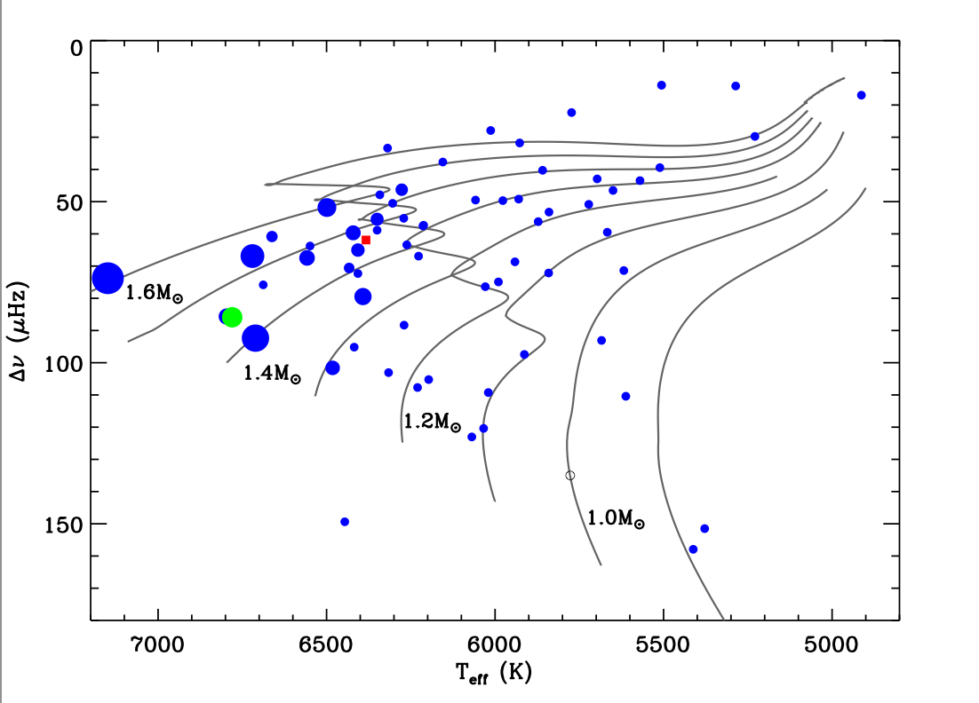
Coming back to surface rotation
P_{rot}<12d
HD49933
[Garcia et al. in preparation]
[García et al. in prep.]
Notes:
S-K is jut the star above 1.4M

Slide 6
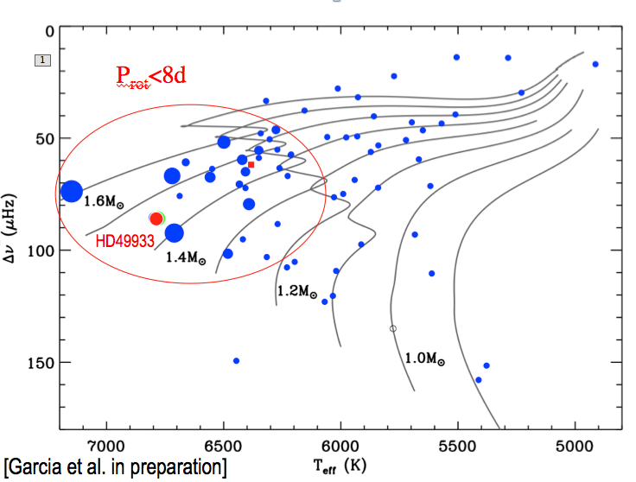
Results: Kepler
Shere-Khan
P_{rot}=2.5d
<S_{ph}> = 250 ppm
Asteroseismology:
M~1.4M
DCZ~3%
We observe:
Magnetic Cycle-like behaviour
Long-lived active longitudes during maximum activity
[Mathur et al. 2014, in press]
Notes:
RV measurement at Mercator does not show signature of close binary

